Slide 1
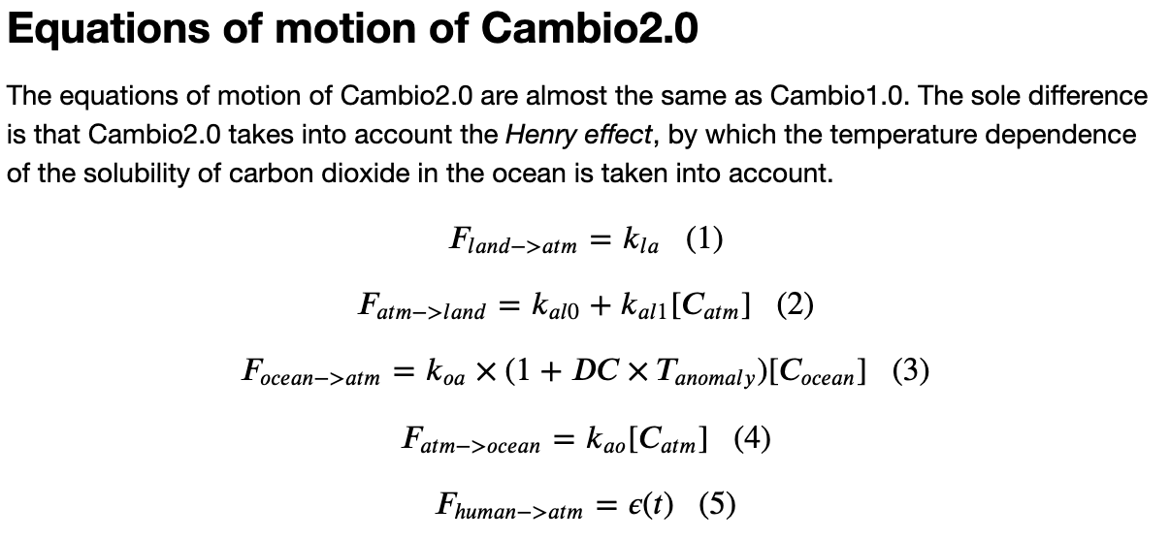

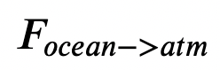
Last time: Why refactor (from Cambio1.0 to Cambio2.0)?
There’s a lot to keep track of (arrays, metadata)
We’re about to make it yet more complex by introducing feedbacks
Cold ocean
Warm ocean
=> it’s a good time to overhaul (“refactor”) how we manage data and algorithms.

Slide 2
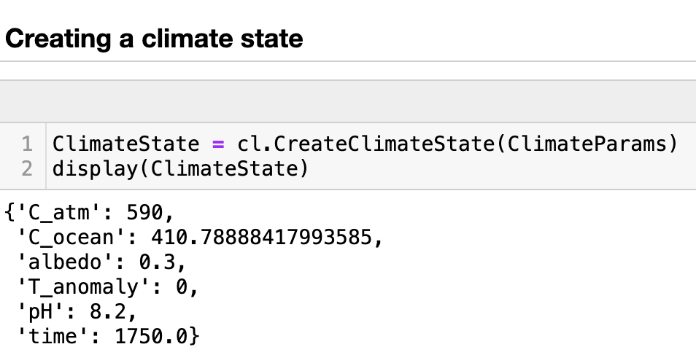
We have a new function that creates an initial climate state (as a dictionary)

Slide 3
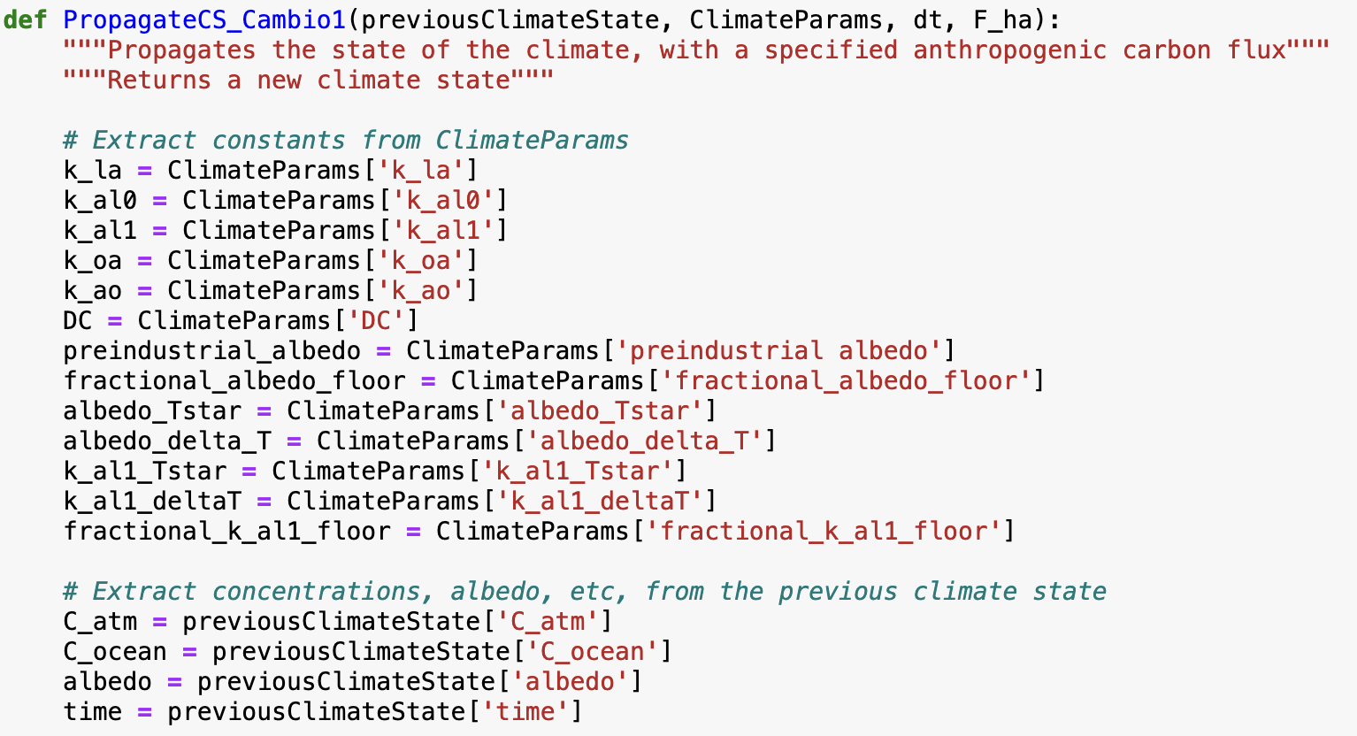


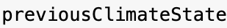
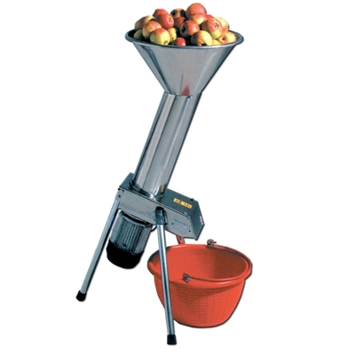

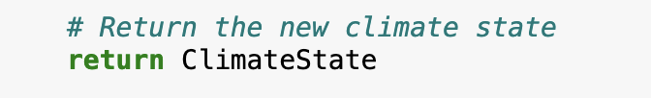
And another function that propagates (nudges) a climate state to a new one a fraction of a year later ($dt$)
…

Slide 4
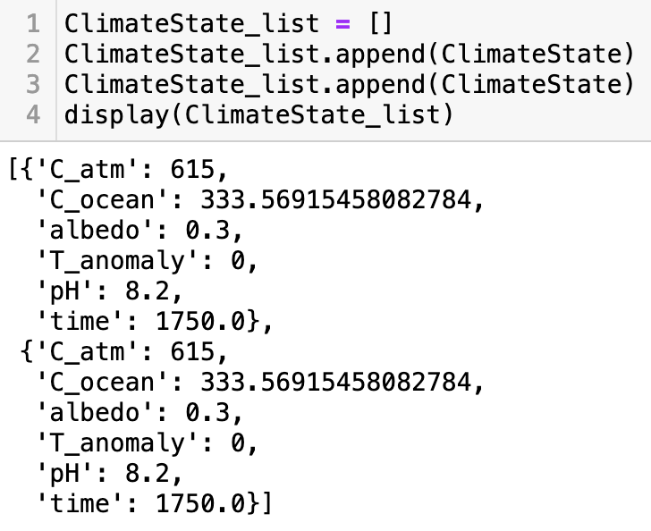
The idea is that we’ll make lists of these climate states, get information out of them later
In this case, the list is just two states long – and very boring because they’re the same climate state.
But in just a bit, you’ll see how Cambio2.0 assembles lists of climate states within an Euler loop!

Slide 5
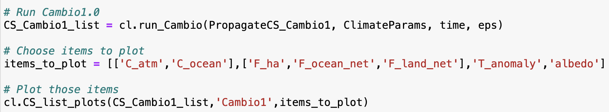
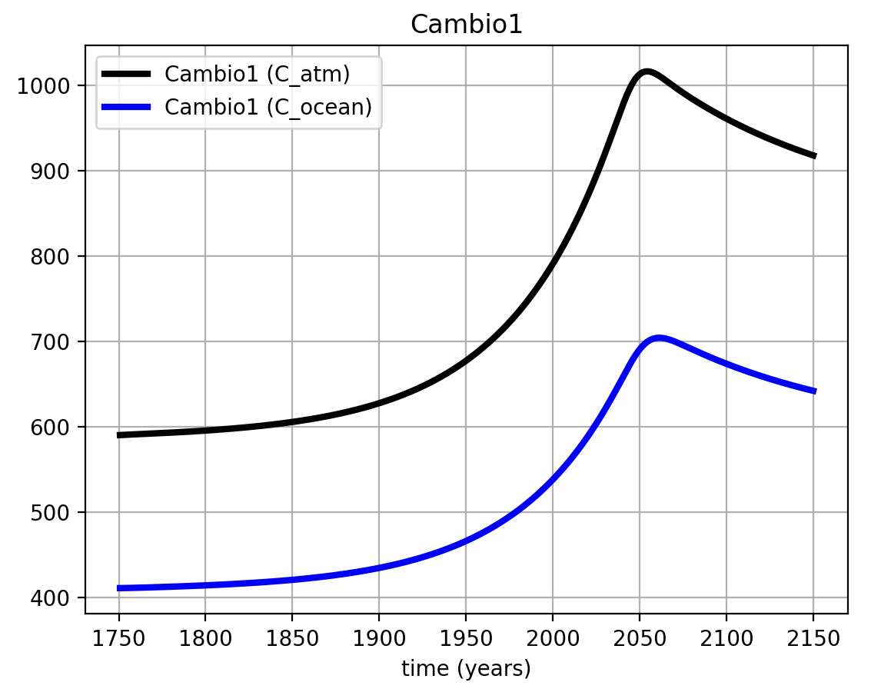
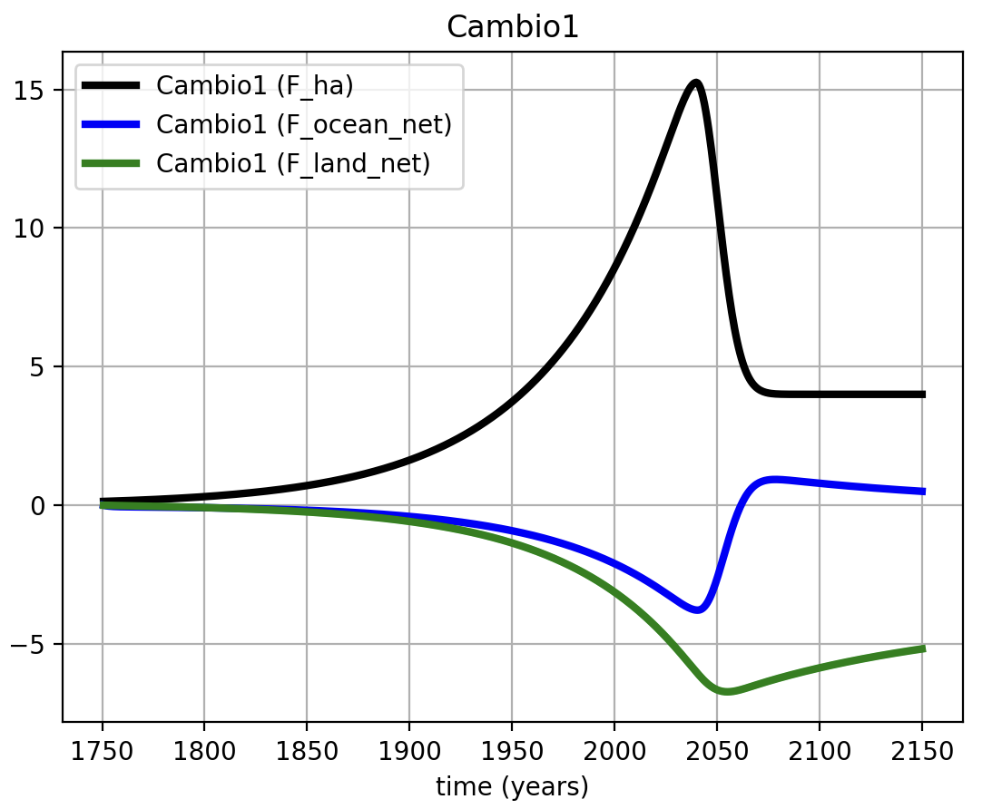
Another new function, cl.run_Cambio, creates a starting climate state (as a dictionary),
then uses the propagator in an Euler loop over all time steps in your emissions scenario
… and the other items

Slide 6
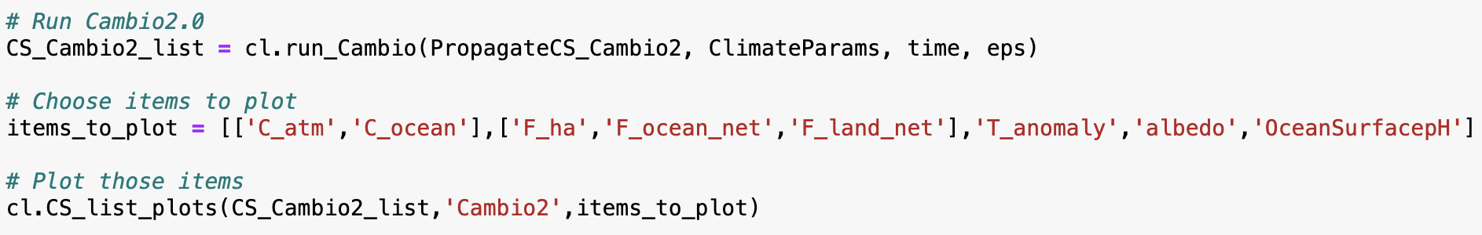
Your job will be to create a propagator for Cambio 2.0, and plot those results too
…

Slide 7
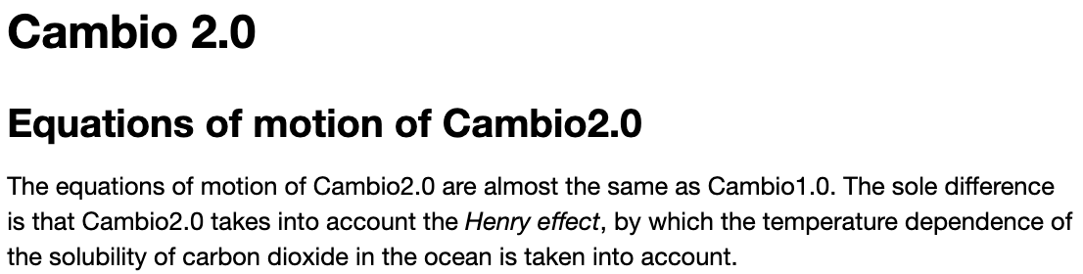
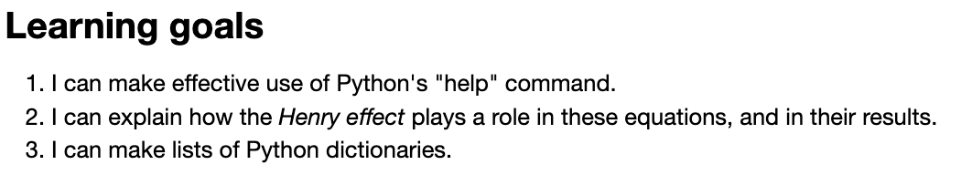
OK, let’s get started
Cold ocean
Warm ocean
Notes:
Predict the temperature if CO2 continues to rise. If we reduce CO2 emissions to zero.

